Slide 1


REGISTRATION FORM Using Html,Cssand jQuery
-M.Nandhini
B.Tech –IT,Dr.NGP IT.

Slide 2
About
In the rar file I have included the html ,css and php file.
In the first page it will get the input from the user and validate using jQuery , if valid will store in the MySQL (using php) and display the fields in the second page.
Otherwise it will shown an error message , till the input fields are valid.

Slide 3
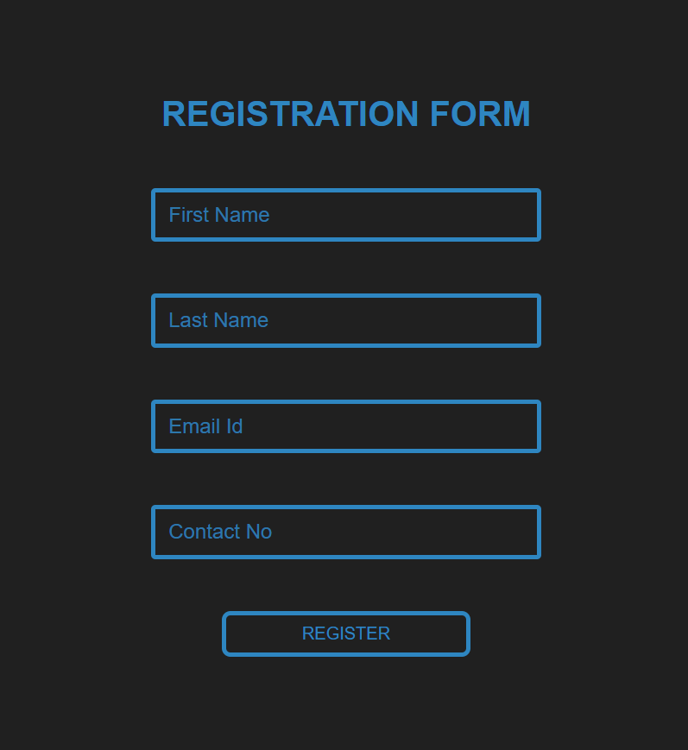
First Page
In the first page , the input field will get the input from the user .
After receiving the input it will automatically validate the values .
It will throw an error message if not will with respect to the type of input field .
If the values are valid it will ask for the confirmation and register it.

Slide 4
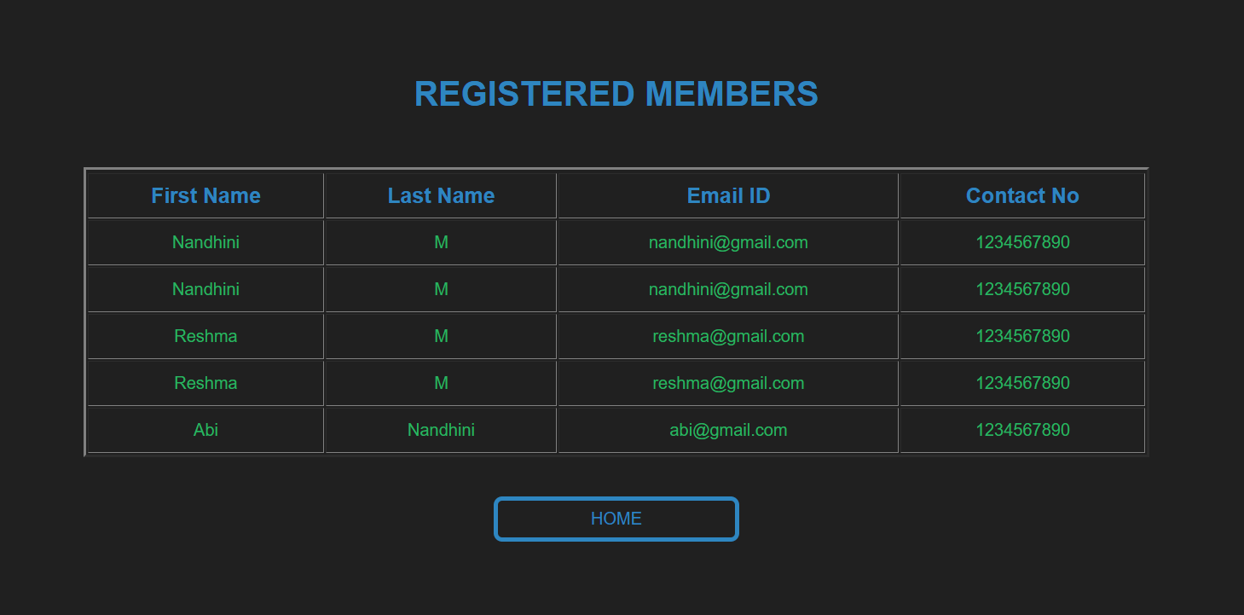
Second Page
In the second page , I have included the table with the values given in the first page.
It will show all the registered user and display with the respective column name.
After that, there is a home button which will redirect you to the first page itself.

Slide 5


THANK
YOU!

